Slide 1








Applying Shockley’s Equation
The transfer curve can also be obtained directly from Shockley’s equation given simply the values of I_{DSS} and V_{P}.
The levels of I_{DSS} and V_{P} define the limits of the curve on both axes and leave only the necessity of finding a few intermediate plot points.
Substituting V_{GS} = 0 V gives
substitute V_{GS}=1 V,
Substituting V_{GS} = V_{P} yields
Note the care taken with the negative signs for V_{GS} and V_{P} in the calculations above.
So for a given I_{DSS} and V_{P} (as is normally provided on specification sheets) the level of I_{D} can be found for any level of V_{GS.}
Also the resulting level of V_{GS} for a given level of I_{D}

Slide 2
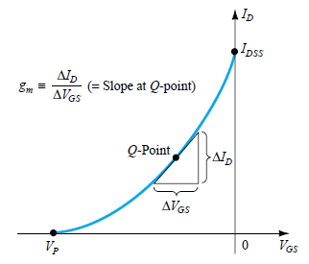

FET PARAMETERS
The gate-to-source voltage controls the drain-to-source (channel) current of an FET.
A dc gate-to-source voltage controlled the level of dc drain current through a relationship known as Shockley’s equation:
I_{D} = I_{DSS}(1 - V_{GS}/V_{P})²
The change in current that will result from a change in gate-to-source voltage can be determined using the transconductance, gm in the following manner:
The root word conductance was chosen for gm because it is determined by a voltage-to-current ratio similar to the ratio that defines the conductance of a resistor
G = 1/R = I/V.
The prefix trans- in the terminology applied to gm reveals that it establishes a relationship between an output and input quantity
Solving for gm from above Eq. we have

Slide 3
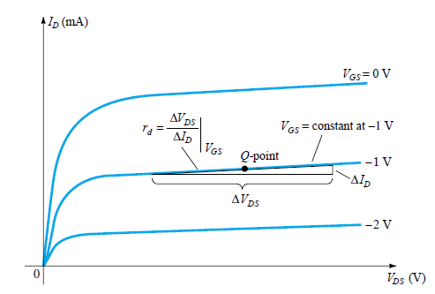




FET Output Impedance r_{d}
The output impedance is defined on the characteristics of Fig. as the slope of the horizontal characteristic curve at the point of operation.
The more horizontal the curve, the greater the output impedance.
If perfectly horizontal, the ideal situation is on hand with the output impedance being infinite (an open circuit)—an often applied approximation.
In equation form,
Note that the voltage V_{GS} remain constant when r_{d} is determined.
Voltage gain A_{v} or Amplification factor (µ)
or
so that
If r_{d} > 10R_{D}:

Slide 5
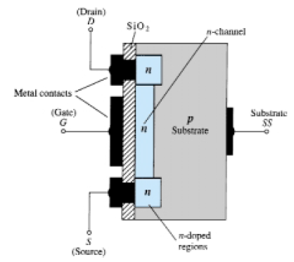
MOSFET (metal-oxide-semiconductor-field-effect transistor )
There are two types of FETs: (i) JFETs and (ii) MOSFETs.
MOSFETs are further broken down into
(i) depletion type and
(ii) enhancement type.
Label MOSFET stands for Metal-Oxide-Semiconductor-Field-Effect Transistor.
The terms depletion and enhancement define their basic mode of operation,
Depletion MOSFET : Basic Construction
The basic construction of the n-channel depletion-type MOSFET is provided in Fig.
A slab of p-type material is formed from a silicon base and is referred to as the substrate.
It is the foundation upon which the device will be constructed.
In some cases the substrate is internally connected to the source terminal.
However, many discrete devices provide an additional terminal labeled SS, resulting in a four-terminal device such as that appearing in Fig.

Slide 6
The source and drain terminals are connected through metallic contacts to n-doped regions linked by an n-channel as shown in the figure.
The gate is also connected to a metal contact surface
but remains insulated from the n-channel by a very thin silicon dioxide (SiO₂) layer.
SiO₂ is a particular type of insulator referred to as a dielectric
Sets up opposing electric fields within the dielectric when exposed to an externally applied field.
The fact that the SiO₂ layer is an insulating layer reveals the following fact
There is no direct electrical connection between the gate terminal and the channel of a MOSFET.
In addition
It is the insulating layer of SiO₂ in the MOSFET construction that accounts for the very desirable high input impedance of the device.
The insulating layer between the gate and channel has resulted in another name for the device: insulated gate FET or IGFET

Slide 7
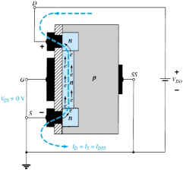
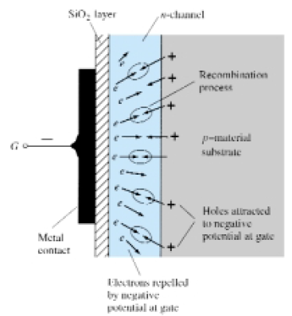
Basic Operation and Characteristics
In Fig. the gate-to-source voltage is set to zero volts by the direct connection from gate-to-source, and
a voltage V_{DS} is applied across the drain-to-source terminals.
The result is an attraction for the positive potential at the drain by the free electrons of the n-channel and a current similar to that established through the channel of the JFET.
The resulting current with V_{GS} = 0 V continues to be labeled as I_{DSS}, as shown in Fig in next slide
In Fig. b, V_{GS} set at a negative voltage V_{GS} = 1V.
The negative potential at the gate will tend to pressure electrons toward the p-type substrate (like charges repel) and attract holes from the p-type substrate (opposite charges attract)
Depending on the magnitude of the negative bias established by V_{GS}, a level of recombination between electrons and holes will occur that will reduce the number of free electrons in the n-channel available for conduction.
The more negative the bias, the higher the rate of recombination.

Slide 8
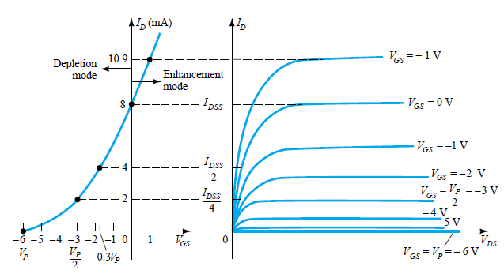
Characteristic curve for MOSFET

Slide 9
The resulting level of drain current is therefore reduced with increasing negative bias for V_{GS} as shown in Fig. for V_{GS} =1 V, 2 V, and so on, to the pinch-off level of 6 V.
The resulting levels of drain current and the plotting of the transfer curve proceeds exactly as for the JFET.
For positive values of V_{GS,} the positive gate will draw additional electrons (free carriers) from the p-type substrate due to the reverse leakage current and
Establish new carriers through the collisions resulting between accelerating particles.
As the gate-to-source voltage continues to increase in the positive direction, Fig. reveals that the drain current will increase at a rapid rate.
One must be aware of the maximum drain current rating since it could be exceeded with a positive gate voltage.
So, the application of a positive gate-to-source voltage has “enhanced” the level of free carriers in the channel compared to that encountered with V_{GS}= 0 V.
For this reason the region of positive gate voltages on the drain or transfer characteristics is often referred to as the enhancement region,
with the region between cutoff and the saturation level of I_{DSS} referred to as the depletion region.
Shockley’s equation applicable for the depletion-type MOSFET characteristics in both the depletion and enhancement regions.
For both regions, it is simply necessary that the proper sign be included with V_{GS} in the equation and the sign be carefully monitored in the mathematical operations.

Slide 10
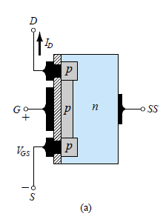
p-Channel Depletion-Type MOSFET
The construction of a p-channel depletion-type MOSFET is exactly the reverse of n-channel depletion-type MOSFET .
That is, there is now an n-type substrate and a p-type channel, as shown in Fig. a.
The terminals remain as same (D,S,G), but all the voltage polarities and the current directions are reversed, as shown in the same figure.
The drain characteristics would appear exactly as in Fig. for n-channel depletion-type MOSFET but with V_{DS} having negative values,
I_{D} having positive values as indicated (since the defined direction is now reversed) and
V_{GS} having the opposite polarities as shown in Fig. c in next slide.
The reversal in V_{GS} will result in a mirror image (about the I_{D} axis) for the transfer characteristics as shown in Fig. b in next slide.
In other words, the drain current will increase from cutoff at V_{GS} = V_{P} in the positive V_{GS} region to I_{DSS} and then continue to increase for increasingly negative values of V_{GS}.
Shockley’s equation is still applicable and requires simply placing the correct sign for both V_{GS} and V_{P} in the equation

Slide 11
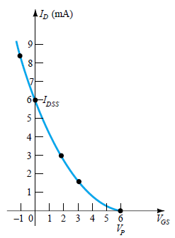
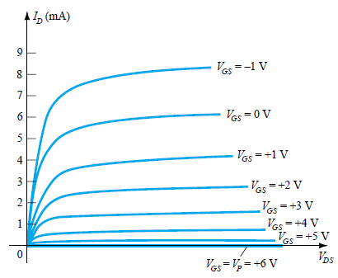
Transfer Characteristics : p-Channel depletion-type MOSFET with I_{DSS} = 6mA and V_{P} =6 V

Slide 12
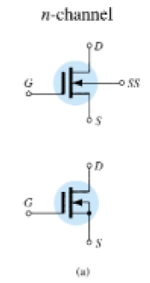
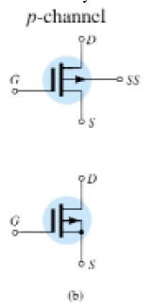
Symbols
The graphic symbols for an n- and p-channel depletion-type MOSFET are provided in Fig.
Here the lack of a direct connection (due to the gate insulation) between the gate
and channel is represented by a space between the gate and the other terminals of the
symbol.
The vertical line representing the channel is connected between the drain and source and is “supported” by the substrate.
Two symbols are provided for each type of channel to reflect the fact that in some cases the substrate is externally available while in others it is not.
For mostly for the analysis the substrate and source will be connected and the lower symbols is employed.
The device appearing in Fig. has three terminals, with the terminal identification
appearing in the same figure.
The specification sheet for a depletion-type MOSFET is similar to that of a JFET.
The levels of V_{P} and I_{DSS} are provided along with a list of maximum values and typical “on” and “off” characteristics.

Slide 14
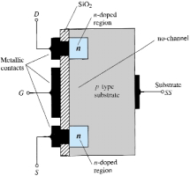
ENHANCEMENT-TYPE MOSFET : Basic Construction
The basic construction of the n-channel enhancement-type MOSFET is provided in Fig.
A slab of p-type material is formed from a silicon base and is again referred to as the substrate.
As with the depletion-type MOSFET, the substrate is some-times internally connected to the source terminal,
while in other cases fourth lead is made available for external control of its potential level.
The source and drain terminals are again connected through metallic contacts to n-doped regions, but note in Fig. the absence of a channel between the two n-doped regions.
This is the primary difference between the construction of depletion-type and enhancement-type MOSFETs—
the absence of a channel as a constructed component
of the device.
The SiO₂ layer is still present to isolate the gate metallic platform from the region between the drain and source,
but now it is simply separated from a section of the p-type material.
In summary, therefore, the construction of an enhancement-typeMOSFET is quite similar to that of the depletion-type MOSFET except for the absence of a channel between the drain and source terminals.

Slide 15
Basic Operation and Characteristics
If V_{GS} = 0 V and a voltage applied between the drain and source of the device of Fig.
the absence of an n-channel will result in a current of effectively zero amperes
Quite different from the depletion-type MOSFET and JFET where I_{D} = I_{DSS.}
It is not sufficient to have a large accumulation
of carriers (electrons) at the drain and source
(due to the n-doped regions)
if a path fails to exist between the two with V_{DS} some positive voltage, V_{GS} at 0 V, and terminal SS directly connected to the source, there are in fact two reverse-biased p-n junctions between the n-doped regions and the p-substrate to oppose any significant flow between drain and source.

Slide 16
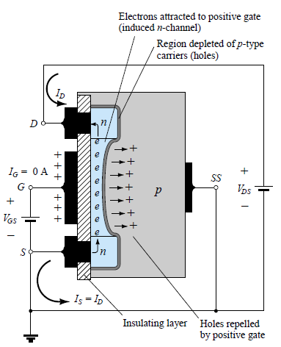
In Fig. both V_{DS} and V_{GS} have been set at some positive voltage greater than 0 V, establishing the drain and gate at a positive potential with respect to the source.
The positive potential at the gate will pressure the holes (since like charges repel) in
the p-substrate along the edge of the SiO₂ layer to leave the area and enter deeper regions of the p-substrate, as shown in the figure.
The result is a depletion region near the SiO₂ insulating layer void of holes.
However, the electrons in the p-substrate (the minority carriers of the material) will be attracted to the positive gate and accumulate
in the region near the surface of the SiO₂ layer.
The SiO₂ layer and its insulating qualities will prevent the negative carriers from being absorbed at the gate terminal.
As V_{GS} increases in magnitude, the concentration of electrons near the SiO₂ surface increases until eventually the induced n-type region can support a measurable flow between drain and source.
The level of V_{GS} that results in the significant increase in drain current is called the threshold voltage and is given the symbol V_{T}

Slide 17
On specification sheets it is referred to as V_{GS(Th),}.
Since the channel is nonexistent with V_{GS} = 0 V and “enhanced” by the application of a positive gate-to-source voltage, this type of MOSFET is called an enhancement-type MOSFET.
Both depletion- and enhancement-type MOSFETs have enhancement-type regions, but the label was applied to the latter since it is its only mode of operation.
As V_{GS} is increased beyond the threshold level, the density of free carriers in the induced channel will increase, resulting in an increased level of drain current.
However, if we hold V_{GS} constant and increase the level of V_{DS}, the drain current will
eventually reach a saturation level as occurred for the JFET and depletion-type MOSFET.
The leveling off of I_{D} is due to a pinching-off process depicted by the narrower channel at the drain end of the induced channel as shown in Fig in next slide.
Applying Kirchhoff’s voltage law to the terminal voltages of the MOSFET of Fig., we find that

Slide 18
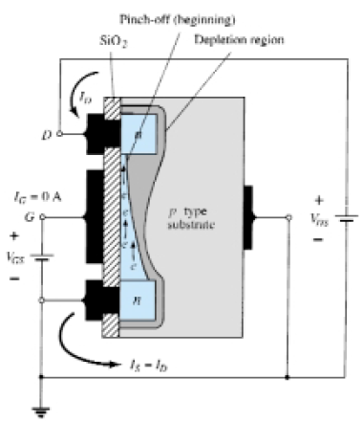

Slide 19
If V_{GS} is held fixed at some value such as 8 V and V_{DS} is increased from 2 to 5 V, the voltage V_{DG} will drop from 6 to 3 V and the gate will become less and less positive with respect to the drain.
This reduction in gate-to-drain voltage will in turn reduce the attractive forces for free carriers (electrons) in this region of the induced channel, causing a reduction in the effective channel width.
Eventually, the channel will be reduced to the point of pinch-off and a saturation condition will be established as described earlier for the JFET and depletion-type MOSFET.
In other words, any further increase in V_{DS} at the fixed value of V_{GS} will not affect the saturation level of I_{D} until breakdown conditions are encountered.
The drain characteristics of Fig. reveal that for the device of Fig. with V_{GS} = 8 V, saturation occurred at a level of V_{DS} = 6 V.
In fact, the saturation level for V_{DS} is related to the level of applied V_{GS} by
Obviously, therefore, for a fixed value of V_{T} , then the higher the level of V_{GS}, the more the saturation level for V_{DS}, as shown in Fig. in next slide by the locus of saturation levels.

Slide 20
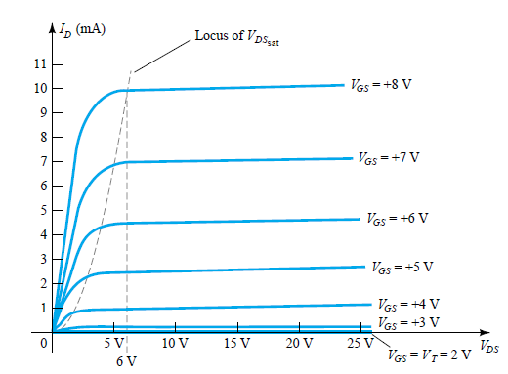

Slide 21

For the characteristics of Fig. the level of V_{T} is 2 V, as revealed by the fact that the drain current has dropped to 0 mA.
In general, therefore:
For values of V_{GS} less than the threshold level, the drain current of an enhancement- type MOSFET is 0 mA.
Figure clearly reveals that as the level of V_{GS} increased from V_{T} to 8 V, the resulting saturation level for I_{D} also increased from a level of 0 to 10 mA.
In addition, it is quite noticeable that the spacing between the levels of V_{GS} increased as the magnitude of V_{GS} increased, resulting in ever-increasing increments in drain current.
For levels of V_{GS} = V_{T} , the drain current is related to the applied gate-to-source voltage by the following nonlinear relationship:
The k term is a constant that is a function of the construction of the device. The value of k can be determined from the following equation

Slide 22
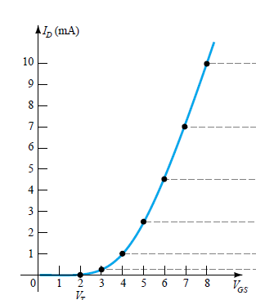
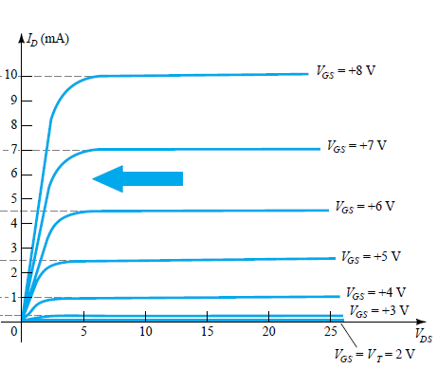
The transfer curve of Fig. is certainly quite different from those obtained earlier.
For an n-channel (induced) device, it is now totally in the positive V_{GS} region and does not rise until V_{GS} = V_{T}.

